Slide 1
Vector Database

Slide 2
Vector Database
Introduction
How does a vector database work?
Indexing Techniques
How to Choose a Similarity Metric
Filtering
Conclusion

Slide 3
Introduction
To use the embedded information repeatedly, we need to store the embeddings so that they can be accessed on demand. For this purpose, we use a special kind of database called a vector database.
Efficient storage and retrieval of embeddings with capabilities like CRUD operations, metadata filtering, and horizontal scaling are crucial for large-scale applications using Retrieval-Augmented Generation(RAGs). Vector databases like ChromaDB, Pinecone, and Weaviate specialize in this, offering fast retrieval and similarity searches.
Integrating the right vector database is crucial for maximizing RAG performance. A thoughtful selection, considering use case intricacies, ensures seamless storage and retrieval, optimizing the power of Retrieval-Augmented Generative models.

Slide 4
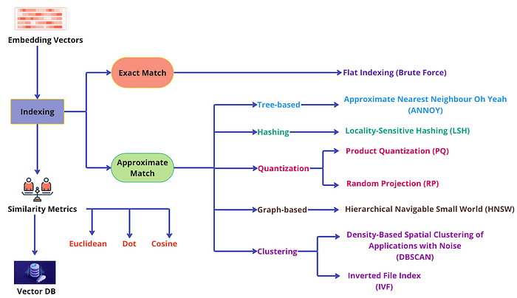
Introduction

Slide 5
How does a vector database work?
Vector Database Vs. Other Databases
Vector Database Vs. Vector Index
Popular Vector Databases
How does a vector database work?

Slide 6
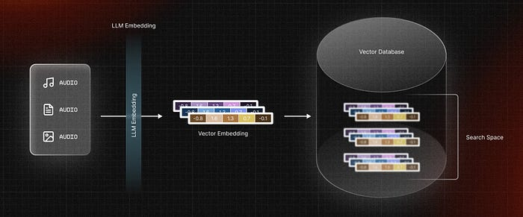
How does a vector database work?

Slide 7
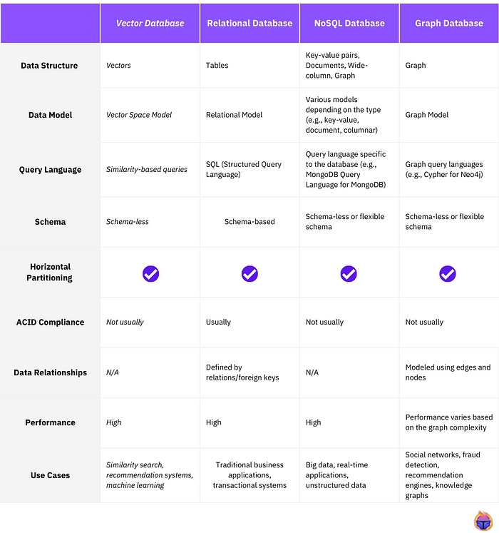
Vector Database Vs. Other Databases

Slide 8
Vector Database Vs. Vector Index
In the tech industry, a prevailing misconception suggests that vector databases are simply wrappers for Approximate Nearest Neighbor (ANN) search algorithms.
At its core, a vector database is a comprehensive solution for unstructured data. Contrary to this misconception, it encompasses user-friendly features found in today’s structured/semi-structured database management systems, including cloud-nativity, multi-tenancy, and scalability. It tackles the limitations of standalone vector indices, addressing scalability challenges, integration complexities, and the lack of real-time updates and built-in security measures.
On the other side, lightweight ANN libraries like FAISS and ScaNN serve as tools to construct vector indices. These libraries aim to accelerate nearest-neighbor searches for multi-dimensional vectors. While suitable for small datasets in production systems, scalability becomes a challenge as datasets grow.

Slide 9
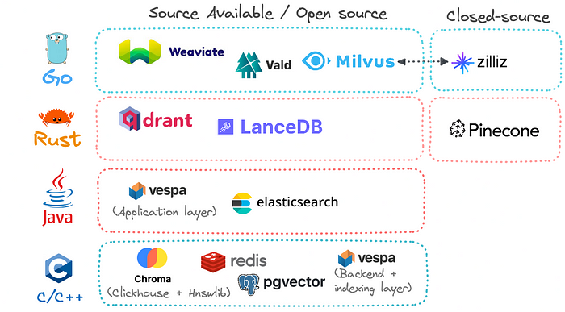
Popular Vector Databases

Slide 10
How does a vector database work?
We all know traditional databases store strings, numbers, and other types of scalar data in rows and columns. On the other hand, a vector database operates on vectors, so the way it’s optimized and queried is quite different.
In traditional databases, we are usually querying for rows in the database where the value usually exactly matches our query. In vector databases, we apply a similarity metric to find a vector that is the most similar to our query.
A vector database uses a combination of different algorithms that all participate in the Approximate Nearest Neighbor (ANN) search. These algorithms optimize the search through various indexing techniques.

Slide 11
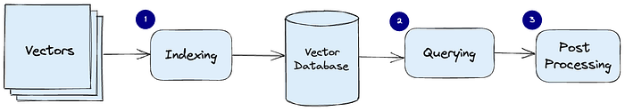
How does a vector database work?
These algorithms are assembled into a pipeline that provides fast and accurate retrieval of the neighbors of a queried vector. Since the vector database provides approximate results, the main trade-offs we consider are between accuracy and speed. The more accurate the result, the slower the query will be. However, a good system can provide ultra-fast search with near-perfect accuracy.
Here’s a common pipeline for a vector database:

Slide 12
How does a vector database work?
Indexing: The vector database indexes vectors using an algorithm such as PQ, LSH, or HNSW (find more on these below). This step maps the vectors to a data structure that will enable faster searching.
Querying: The vector database compares the indexed query vector to the indexed vectors in the dataset to find the nearest neighbors (applying a similarity metric used by that index)
Post Processing: In some cases, the vector database retrieves the final nearest neighbors from the dataset and post-processes them to return the final results. This step can include re-ranking the nearest neighbors using a different similarity measure.

Slide 13
Indexing Techniques
Tree-based methods
Quantization methods
Hashing methods
Clustering methods
Graph methods

Slide 14
Indexing Techniques
Tree-based methods are efficient for low-dimensional data and offer exact nearest neighbor search. However, their performance generally degrades in high-dimensional spaces due to the “curse of dimensionality”. They also require substantial memory and are less efficient for large datasets, leading to longer build times and higher latency.
Quantization methods are memory-efficient and offer fast search times by compressing vectors into compact codes. However, this compression can lead to a loss of information, potentially reducing search accuracy. Additionally, these methods can be computationally expensive during the training phase, increasing build time.

Slide 15
Indexing Techniques
Hashing methods are fast and relatively memory-efficient, mapping similar vectors to the same hash bucket. They perform well with high-dimensional data and large-scale datasets, offering high throughput; However, the quality of search results can be lower due to hash collisions leading to false positives and negatives. Choosing the right number of hash functions and the number of hash tables are imperative as they significantly affect performance.
Clustering methods can expedite search operations by narrowing down the search space to a specific cluster, but the accuracy of the search results can be influenced by the quality of the clustering. Clustering is typically a batch process, which means it’s not well-suited to dynamic data where new vectors are constantly being added, leading to frequent re-indexing.

Slide 16
Indexing Techniques
Graph methods provide a good balance between accuracy and speed. They are efficient for high-dimensional data and can provide high-quality search results. However, they can be memory-intensive, as they need to store the graph structure, and the construction of the graph can also be computationally expensive.

Slide 17
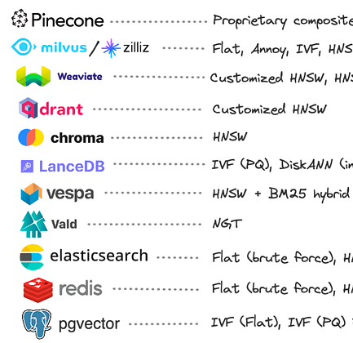
Indexing Techniques
The choice of algorithm in a vector database depends on the specific requirements of the task, including the size and dimensionality of the dataset, the available computational resources, and the acceptable trade-off between accuracy and efficiency. It’s also worth noting that many modern vector databases use hybrid methods, combining the strengths of different methods to achieve high speed and accuracy.

Slide 18
Indexing Techniques
Exact Match
Flat Indexing (Brute Force)
Approximate Match
Annoy (Approximate Nearest Neighbor Oh Yeah)
Inverted File (IVF) Indexing
Random Projection (RP)
Product Quantization (PQ)
Locality-Sensitive Hashing (LSH)
Hierarchical Navigable Small World (HNSW)
Density-Based Spatial Clustering of Applications with Noise (DBSCAN)

Slide 19
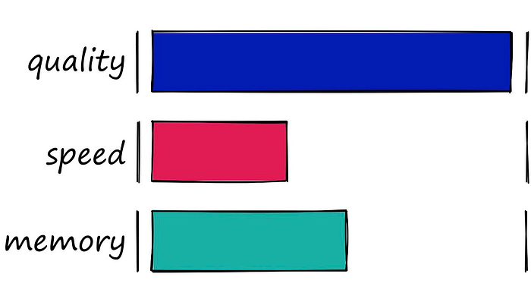
Exact Match - Flat Indexing (Brute Force)

Slide 20
Exact Match - Flat Indexing (Brute Force)
The very first indexes we should look at are the simplest — flat indexes.
Flat indexes are ‘flat’ because we do not modify the vectors that we feed into them.
Because there is no approximation or clustering of our vectors — these indexes produce the most accurate results. We have perfect search quality, but this comes at the cost of significant search times.

Slide 21
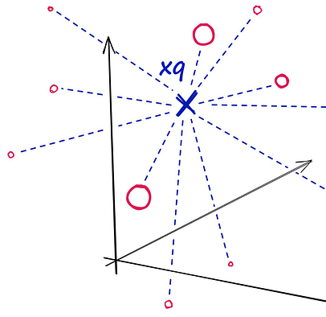
Exact Match - Flat Indexing (Brute Force)
With flat indexes, we introduce our query vector xq and compare it against every other full-size vector in our index — calculating the distance to each.

Slide 22
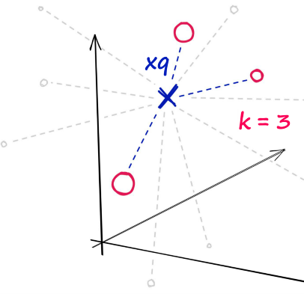
Exact Match - Flat Indexing (Brute Force)
After calculating all of these distances, we will return the nearest k of those as our nearest matches. A k-nearest neighbors (kNN) search.

Slide 23
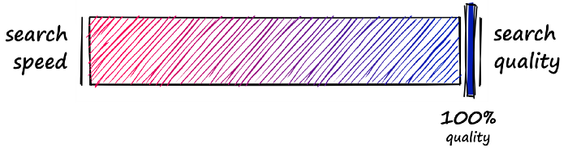
Balancing Search Time
Flat indexes are brilliantly accurate but terribly slow. In similarity search, there is always a trade-off between search-speed and search-quality (accuracy).
What we must do is identify where our use-case sweet spot lies. With flat indexes, we are here:

Slide 24
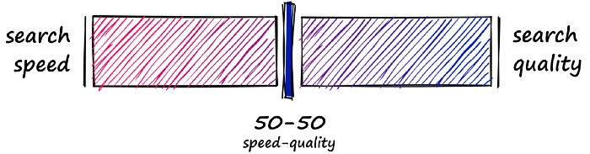
Balancing Search Time
Here we have completely unoptimized search-speeds, which will fit many smaller index use-cases — or scenarios where search-time is irrelevant. But, other use-cases require a better balance speed and quality.
So, how can we make our search faster? There are two primary approaches:
Reduce vector size — through dimensionality reduction or reducing the number of bits representing our vectors values.
Reduce search scope — we can do this by clustering or organizing vectors into tree structures based on certain attributes, similarity, or distance — and restricting our search to closest clusters or filter through most similar branches.
Using either of these approaches means that we are no longer performing an exhaustive nearest-neighbors search but an approximate nearest-neighbors (ANN) search — as we no longer search the entire, full-resolution dataset.
So, what we produce is a more balanced mix that prioritizes both search-speed and search-time:

Slide 25
Approximate Match
Annoy (Approximate Nearest Neighbor Oh Yeah)
Inverted File (IVF) Indexing
Random Projection (RP)
Product Quantization (PQ)
Locality-Sensitive Hashing (LSH)
Hierarchical Navigable Small World (HNSW)
Density-Based Spatial Clustering of Applications with Noise (DBSCAN)

Slide 26
Annoy (Approximate Nearest Neighbor Oh Yeah)
Among the tree-based algorithms used in vector databases, one stands out for its efficiency and simplicity: Annoy, or “Approximate Nearest Neighbors Oh Yeah”. Annoy is a C++ library with Python bindings that is designed by Spotify to search for points in space that are close to a given query point(approximate match). It creates large read-only, file-based data structures that are memory-mapped into memory, which allows multiple processes to share the same data.
Annoy operates by using a forest of Random Projection trees to perform an efficient ANN search. The algorithm projects points onto random hyperplanes and partitions the space according to which side of the hyperplane the points fall on. This process is repeated recursively, resulting in a binary tree of partitions. A forest of trees is created each with a different random seed. When a query point is received, the algorithm traverses down each tree in the forest to find the leaf node where the point would belong. The nearest neighbors are then approximated by collecting a list of points in the leaf nodes found in all trees and returning the top-k points from this list that are closest to the query point.

Slide 27
Annoy (Approximate Nearest Neighbor Oh Yeah)
Annoy is particularly well-suited for high-dimensional data, where an exact nearest-neighbor search can be prohibitively expensive. It is used in production at Spotify for music recommendations, where it helps find similar songs based on their audio features. Thus, accuracy can be influenced by the number of trees in the forest and the number of points inspected during the search, both of which can be tuned and adjusted based on the specific requirements of the task.
The efficiency and memory efficiency of Annoy makes it a strong choice for handling high-dimensional data and large databases. There are a few trade-offs to consider. Building the index can take a significant amount of time, especially for large datasets. Because Annoy uses a random forest partitioning algorithm, the indices cannot be updated with new data and must be rebuilt from scratch. Depending on the size of your data set or how often your data changes, retraining the index might be prohibitively expensive.

Slide 28
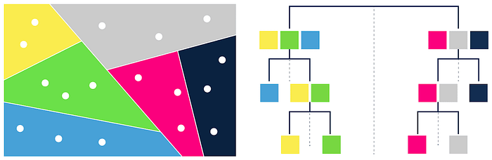
Annoy (Approximate Nearest Neighbor Oh Yeah)

Slide 29
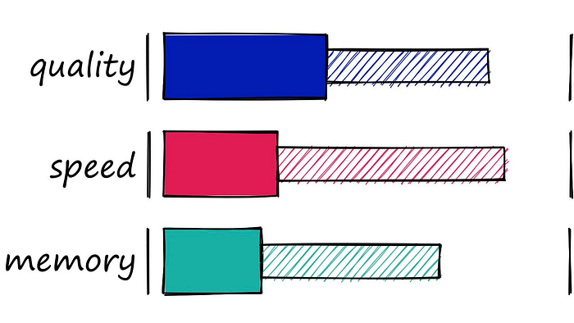
Locality-Sensitive Hashing (LSH)
LSH — a wide range of performances heavily dependent on the parameters set. Good quality results in slower search, and fast search results in worse quality. Poor performance for high-dimensional data. The ‘half-filled’ segments of the bars represent the range in performance encountered while modifying index parameters.
Locality Sensitive Hashing (LSH) works by grouping vectors into buckets by processing each vector through a hash function that maximizes hashing collisions — rather than minimizing as is usual with hashing functions.

Slide 30
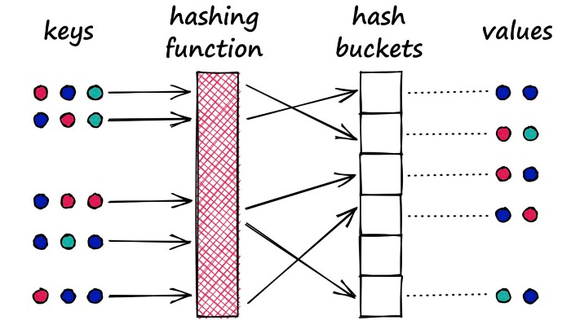
Locality-Sensitive Hashing (LSH)
What does that mean? Imagine we have a Python dictionary. When we create a new key-value pair in our dictionary, we use a hashing function to hash the key. This hash value of the key determines the ‘bucket’ where we store its respective value:

Slide 31
Locality-Sensitive Hashing (LSH)
A Python dictionary is an example of a hash table using a typical hashing function that minimizes hashing collisions, a hashing collision where two different objects (keys) produce the same hash.
In our dictionary, we want to avoid these collisions as it means that we would have multiple objects mapped to a single key — but for LSH, we want to maximize hashing collisions.
Why would we want to maximize collisions? Well, for search, we use LSH to group similar objects together. When we introduce a new query object (or vector), our LSH algorithm can be used to find the closest matching groups:

Slide 32
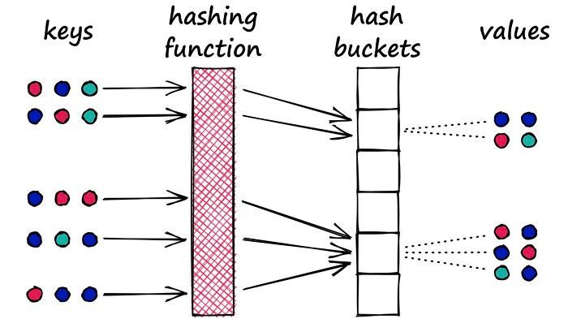
Locality-Sensitive Hashing (LSH)

Slide 33
Locality-Sensitive Hashing (LSH)
Performing search with LSH consists of three steps:
Index all of our vectors into their hashed vectors.
Introduce our query vector (search term). It is hashed using the same LSH function.
Compare our hashed query vector to all other hash buckets via Hamming distance — identifying the nearest.

Slide 34
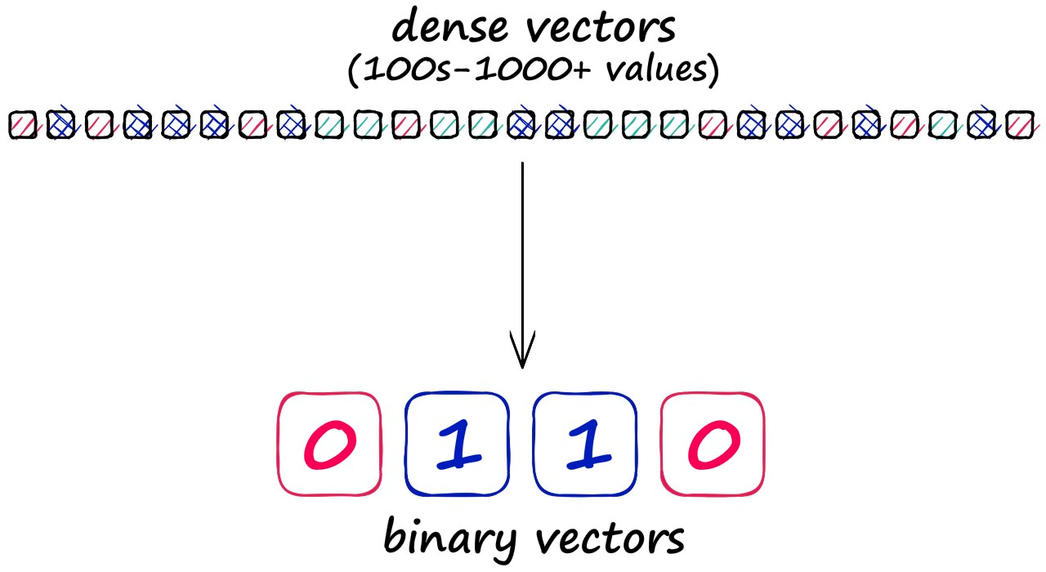
Effects of Approximation
Before diving into the detail of LSH, we should note that grouping vectors into lower resolution hashed vectors also means that our search is not exhaustive (e.g., comparing every vector), so we expect a lower search quality.

Slide 35
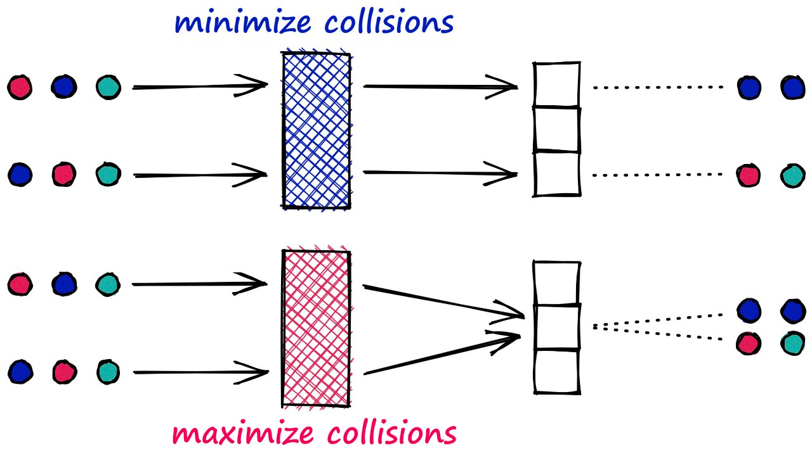
Locality-Sensitive Hashing (LSH)
Unlike most hashing functions, which aim to minimize hashing collisions — LSH algorithms aim to maximize hashing collisions.
This result for LSH is that similar vectors produce the same hash value and are bucketed together. In contrast, dissimilar vectors will hopefully not produce the same hash value — being placed in different buckets.

Slide 36
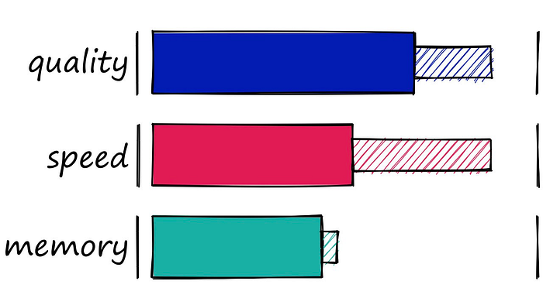
Inverted File (IVF) Indexing

Slide 37
Inverted File (IVF) Indexing
The Inverted File Index (IVF) index consists of search scope reduction through clustering. It’s a very popular index as it’s easy to use, with high search quality and reasonable search speed.
It works on the concept of Voronoi diagrams — also called Dirichlet tessellation (a much cooler name).
To understand Voronoi diagrams, we need to imagine our highly-dimensional vectors placed into a 2D space. We then place a few additional points in our 2D space, which will become our ‘cluster’ (Voronoi cells in our case) centroids.

Slide 38
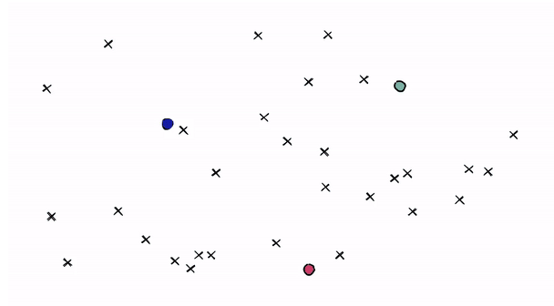
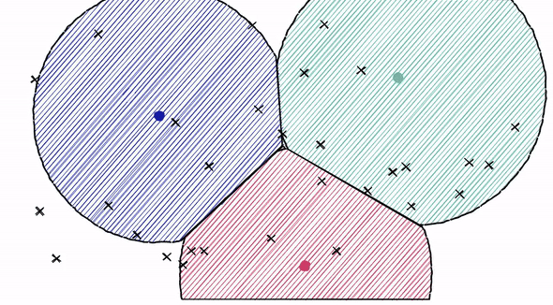
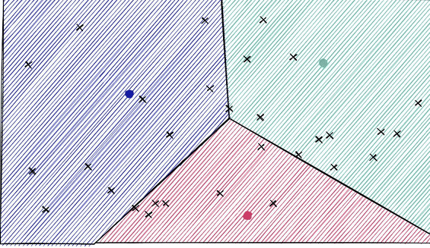
Inverted File (IVF) Indexing
We then extend an equal radius out from each of our centroids. At some point, the circumferences of each cell circle will collide with another — creating our cell edges:

Slide 39
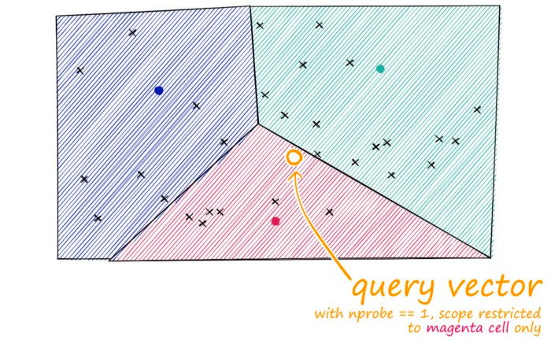
Inverted File (IVF) Indexing
Now, every datapoint will be contained within a cell — and be assigned to that respective centroid.
Just as with our other indexes, we introduce a query vector xq — this query vector must land within one of our cells, at which point we restrict our search scope to that single cell.
But there is a problem if our query vector lands near the edge of a cell — there’s a good chance that its closest other datapoint is contained within a neighboring cell. We call this the edge problem:

Slide 40
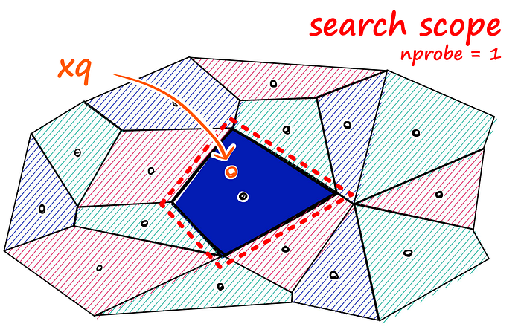
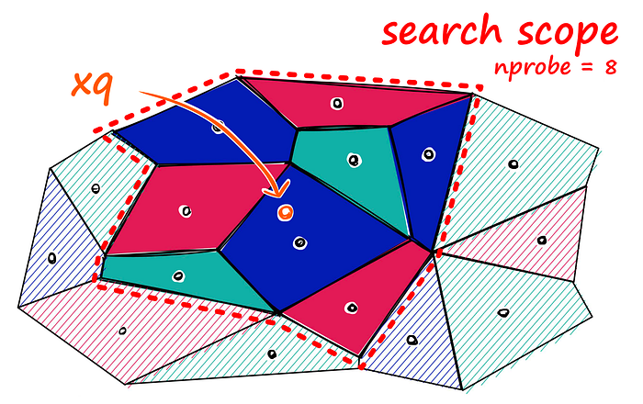
Inverted File (IVF) Indexing
Now, what we can do to mitigate this issue and increase search-quality is increase an index parameter known as the nprobe value. With nprobe we can set the number of cells to search.

Slide 41
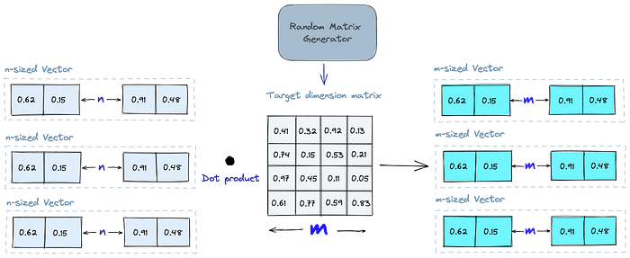
Random Projection (RP)
The basic idea behind random projection is to project the high-dimensional vectors to a lower-dimensional space using a random projection matrix. We create a matrix of random numbers. The size of the matrix is going to be the target low-dimension value we want. We then calculate the dot product of the input vectors and the matrix, which results in a projected matrix that has fewer dimensions than our original vectors but still preserves their similarity.

Slide 42
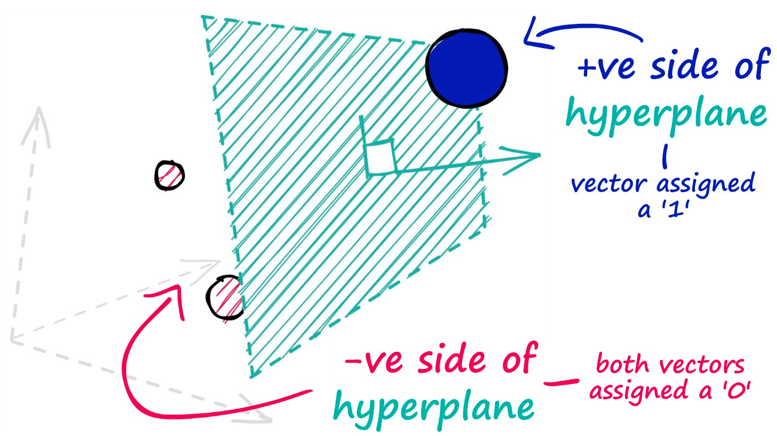
Creating Hyperplanes
The hyperplanes in this method are used to split our datapoints and assign a value of 0 for those data points that appear on the negative side of our hyperplane — and a value of 1 for those that appear on the positive side.

Slide 43
Random Projection (RP)
When we query, we use the same projection matrix to project the query vector onto the lower-dimensional space. Then, we compare the projected query vector to the projected vectors in the database to find the nearest neighbors. Since the dimensionality of the data is reduced, the search process is significantly faster than searching the entire high-dimensional space.
Just keep in mind that random projection is an approximate method, and the projection quality depends on the properties of the projection matrix. In general, the more random the projection matrix is, the better the quality of the projection will be. However, generating a truly random projection matrix can be computationally expensive

Slide 44
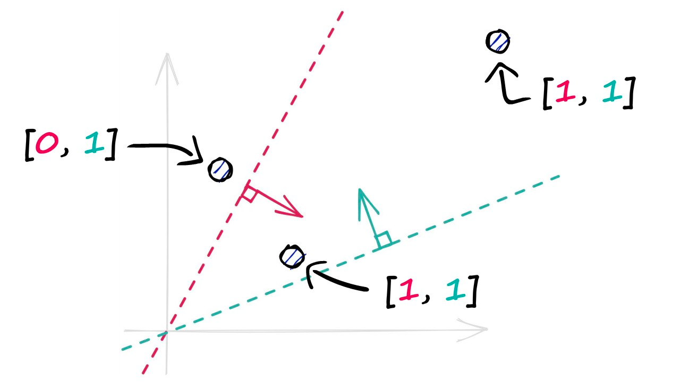
Random Projection (RP)
A single binary value doesn’t tell us much about the similarity of our vectors, but when we begin adding more hyperplanes — the amount of encoded information rapidly increases.
By projecting our vectors into a lower-dimensional space using these hyperplanes, we produce our new hashed vectors.

Slide 45
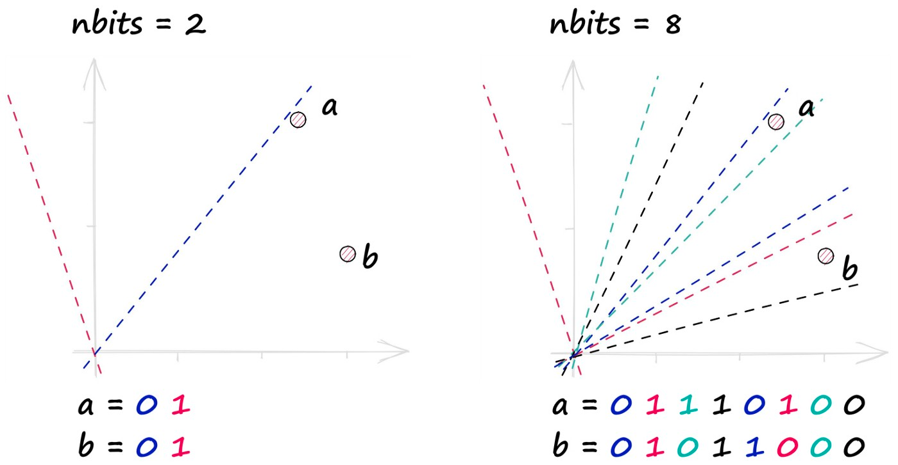
Balancing Quality vs. Speed
In reality, we use many more hyperplanes — more hyperplanes mean higher resolution binary vectors — producing much more precise representations of our vectors.
We control this resolution through hyperplanes with the nbits value. A higher nbits value improves search quality by increasing the resolution of hashed vectors.

Slide 46
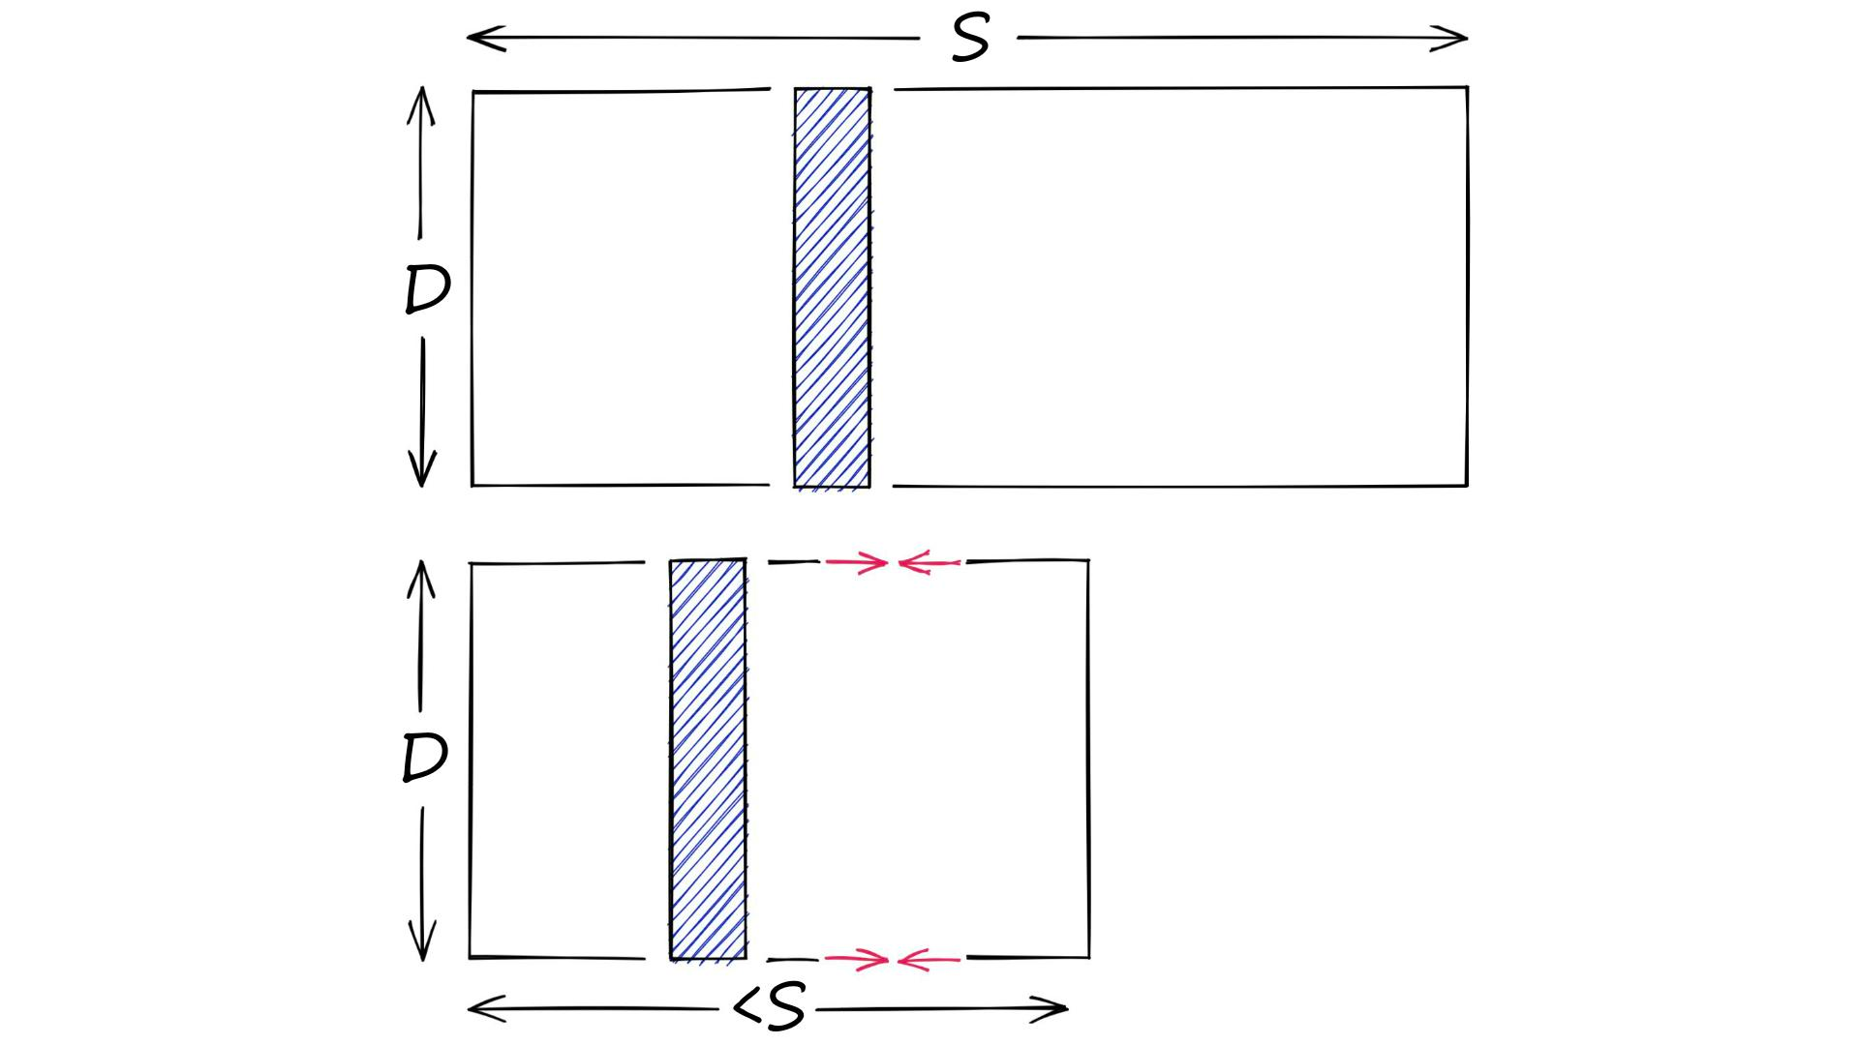
What is Quantization
Let’s say we have a high-dimensional vector, it has a dimensionality of 128. These values are 32-bit floats in the range of 0.0 -> 157.0 (our scope S). Through dimensionality reduction, we aim to produce another, lower-dimensionality vector.
On the other hand, we have quantization. Quantization does not care about dimensionality D. Instead, it targets the potential scope of values. Rather than reducing D, we reduce S.

Slide 47
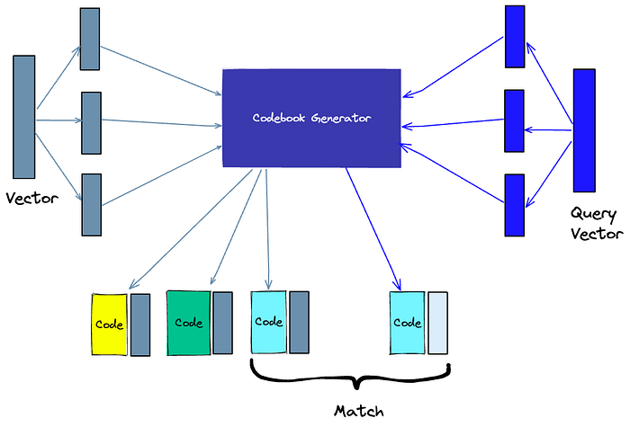
Product Quantization (PQ)
Another way to build an index is product quantization (PQ), which is a lossy compression technique for high-dimensional vectors (like vector embeddings). It takes the original vector, breaks it up into smaller chunks, simplifies the representation of each chunk by creating a representative “code” for each chunk, and then puts all the chunks back together — without losing information that is vital for similarity operations. The process of PQ can be broken down into four steps: splitting, training, encoding, and querying.

Slide 48
How Product Quantization Works
Let’s work through the logic of PQ. We would usually have many vectors (all of equal length) — but for the sake of simplicity, we will use a single vector in our examples.
In short, PQ is the process of:
Taking a big, high-dimensional vector,
Splitting it into equally sized chunks — our subvectors,
Assigning each of these subvectors to its nearest centroid (also called reproduction/reconstruction values),
Replacing these centroid values with unique IDs — each ID represents a centroid

Slide 49
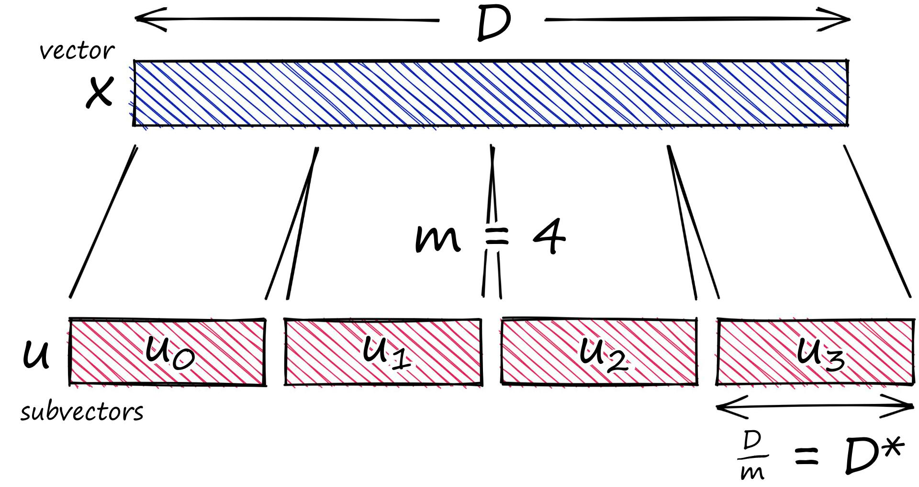
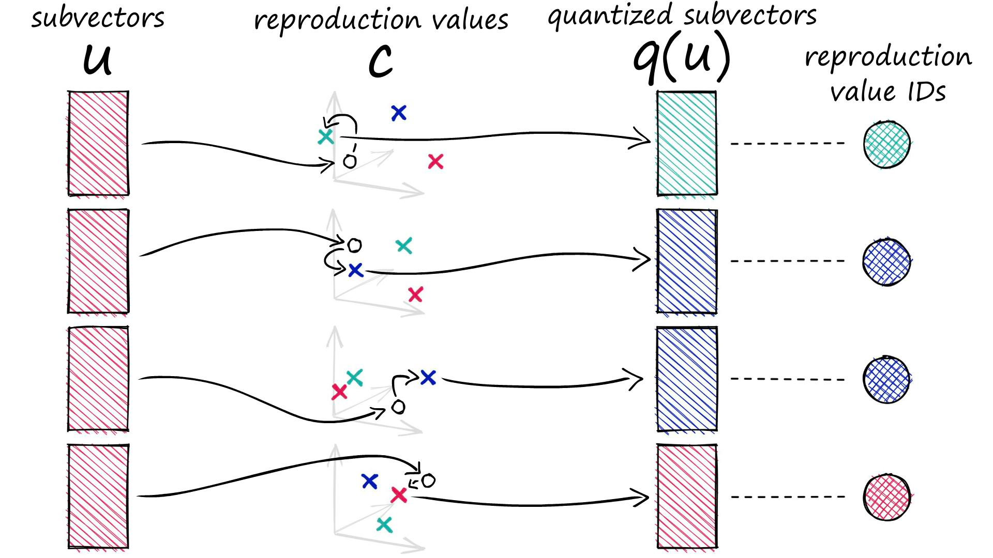
How Product Quantization Works

Slide 50
Product Quantization (PQ)
Splitting -The vectors are broken into segments.
Training — we build a “codebook” for each segment. Simply put — the algorithm generates a pool of potential “codes” that could be assigned to a vector. In practice — this “codebook” is made up of the center points of clusters created by performing k-means clustering on each of the vector’s segments. We would have the same number of values in the segment codebook as the value we use for the k-means clustering.
Encoding — The algorithm assigns a specific code to each segment. In practice, we find the nearest value in the codebook to each vector segment after the training is complete. Our PQ code for the segment will be the identifier for the corresponding value in the codebook. We could use as many PQ codes as we’d like, meaning we can pick multiple values from the codebook to represent each segment.
Querying — When we query, the algorithm breaks down the vectors into sub-vectors and quantizes them using the same codebook. Then, it uses the indexed codes to find the nearest vectors to the query vector.

Slide 51
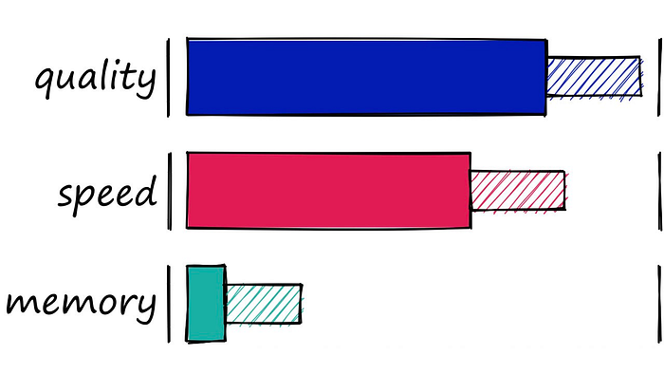
Hierarchical Navigable Small World (HNSW)

Slide 52
Foundations of HNSW
We can split ANN algorithms into three distinct categories; trees, hashes, and graphs. HNSW slots into the graph category. More specifically, it is a proximity graph, in which two vertices are linked based on their proximity (closer vertices are linked) — often defined in Euclidean distance.
There is a significant leap in complexity from a ‘proximity’ graph to ‘hierarchical navigable small world’ graph. We will describe two fundamental techniques that contributed most heavily to HNSW: the probability skip list, and navigable small world graphs.

Slide 53
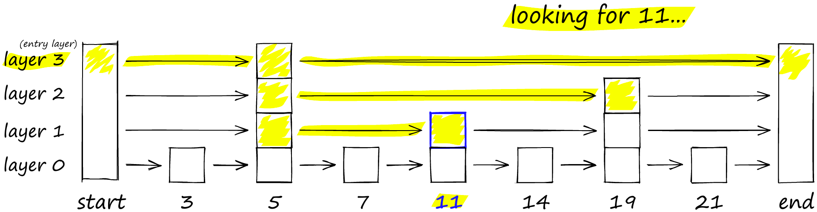
Probability Skip List
The probability skip list was introduced way back in 1990 by William Pugh [2]. It allows fast search like a sorted array, while using a linked list structure for easy (and fast) insertion of new elements (something that is not possible with sorted arrays).
Skip lists work by building several layers of linked lists. On the first layer, we find links that skip many intermediate nodes/vertices. As we move down the layers, the number of ‘skips’ by each link is decreased.​
To search a skip list, we start at the highest layer with the longest ‘skips’ and move along the edges towards the right (below). If we find that the current node ‘key’ is greater than the key we are searching for — we know we have overshot our target, so we move down to previous node in the next level.

Slide 54
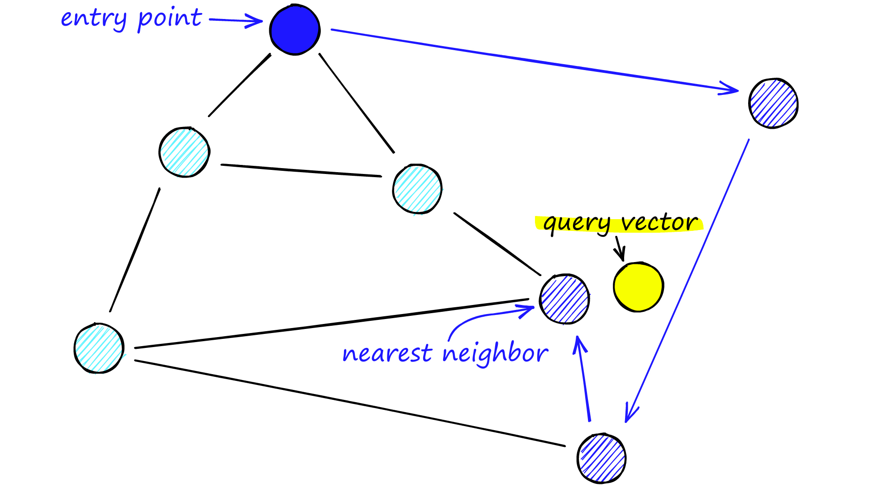
Navigable Small World Graphs
Vector search using Navigable Small World (NSW) graphs was introduced over the course of several papers from 2011-14 [4, 5, 6]. The idea is that if we take a proximity graph but build it so that we have both long-range and short-range links, then search times are reduced to (poly/)logarithmic complexity.
Each vertex in the graph connects to several other vertices. We call these connected vertices friends, and each vertex keeps a friend list, creating our graph.
When searching an NSW graph, we begin at a pre-defined entry-point. This entry point connects to several nearby vertices. We identify which of these vertices is the closest to our query vector and move there.

Slide 55
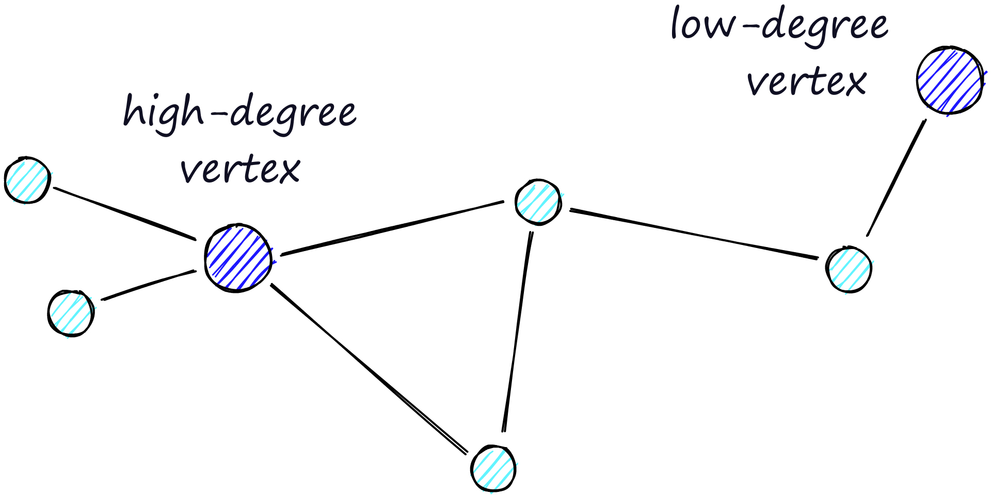
Navigable Small World Graphs
The routing (literally the route we take through the graph) consists of two phases. We start with the “zoom-out” phase where we pass through low-degree vertices (degree is the number of links a vertex has) — and the later “zoom-in” phase where we pass through higher-degree vertices.
Our stopping condition is finding no nearer vertices in our current vertex’s friend list. Because of this, we are more likely to hit a local minimum and stop too early when in the zoom-out phase (fewer links, less likely to find a nearer vertex).

Slide 56
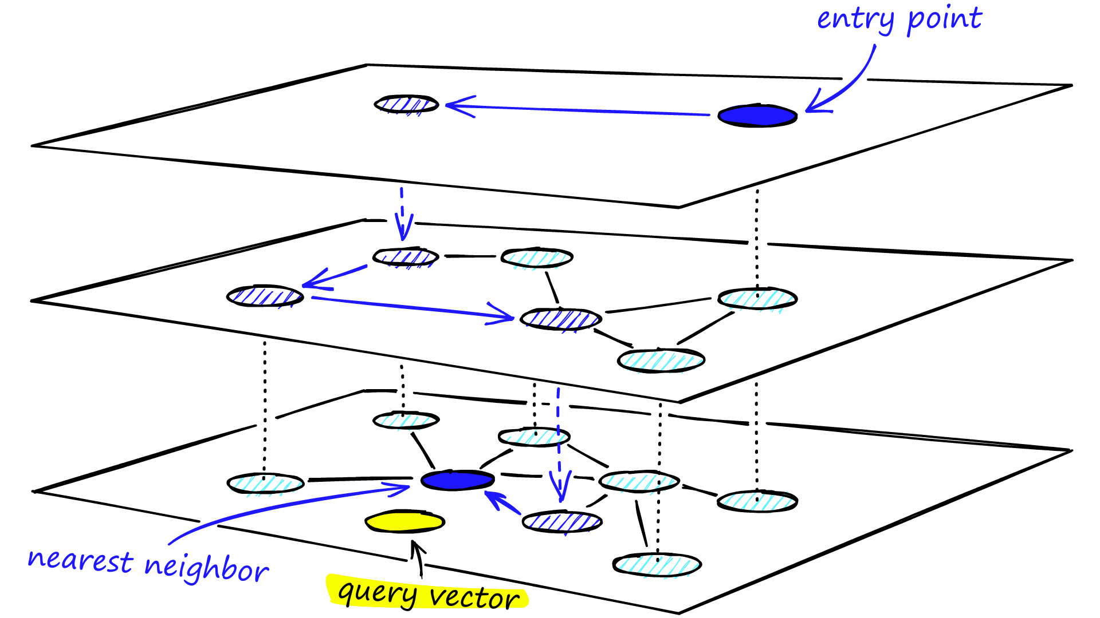
Hierarchical Navigable Small World (HNSW)
During the search, we enter the top layer, where we find the longest links. These vertices will tend to be higher-degree vertices (with links separated across multiple layers), meaning that we, by default, start in the zoom-in phase described for NSW.
We traverse edges in each layer just as we did for NSW, greedily moving to the nearest vertex until we find a local minimum. Unlike NSW, at this point, we shift to the current vertex in a lower layer and begin searching again. We repeat this process until finding the local minimum of our bottom layer — layer 0.

Slide 57
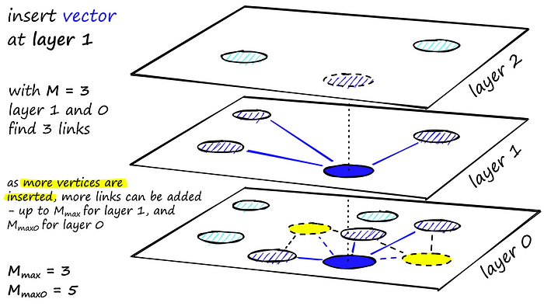
Hierarchical Navigable Small World (HNSW)
HNSW creates a hierarchical, tree-like structure where each node of the tree represents a set of vectors. The edges between the nodes represent the similarity between the vectors. The algorithm starts by creating a set of nodes, each with a small number of vectors. This could be done randomly or by clustering the vectors with algorithms like k-means, where each cluster becomes a node.

Slide 58
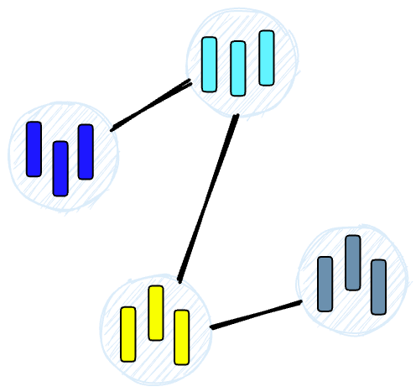
Hierarchical Navigable Small World (HNSW)
The algorithm then examines the vectors of each node and draws an edge between that node and the nodes that have the most similar vectors to the one it has.

Slide 59
Density-Based Spatial Clustering of Applications with Noise (DBSCAN)
DBSCAN operates on the idea of density reachability and density connectivity. It starts with an arbitrary point in the dataset, and if there are at least ‘minPts’ within a given radius ‘eps’ from that point, a new cluster is created. Eps stands for epsilon which is a user-defined input denoting the maximum distance between two points to be considered in a cluster, while minPts refer to the minimum number of data points required to form a cluster. The algorithm then iteratively adds all directly reachable points within the ‘eps’ radius to the cluster. This process continues until no further points can be added to the cluster. Then, the algorithm proceeds to the next unvisited point in the dataset and repeats the process until all points have been visited. The key parameters in DBSCAN are ‘eps’ and ‘minPts’, which define the cluster of points and the minimum density of points required to form a cluster respectively.

Slide 60
Improving Memory Usage and Search Speeds
HNSW is not the best index in terms of memory utilization. However, if this is important and using another index isn’t an option, we can improve it by compressing our vectors using product quantization (PQ). Using PQ will reduce recall and increase search time — but as always, much of ANN is a case of balancing these three factors.
If, instead, we’d like to improve our search speeds — we can do that too! All we do is add an IVF component to our index. There is plenty to discuss when adding IVF or PQ to our index, so we wrote an entire article on mixing-and-matching of indexes.

Slide 61
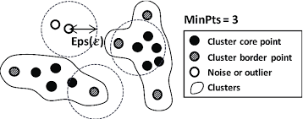
Density-Based Spatial Clustering of Applications with Noise (DBSCAN)

Slide 62
Adaptation - Methods for foundation model adaptation
Factor 1: Compute budget
Factor 2: Data availability
Factor 3: Access to foundation model gradients

Slide 63
Similarity Measures: Distance Metrics
Similarity measures are mathematical methods for determining how similar two vectors are in a vector space. Similarity measures are used in vector databases to compare the vectors stored in the database and find the ones that are most similar to a given query vector.
Several similarity measures can be used, including:
Cosine similarity: measures the cosine of the angle between two vectors in a vector space. It ranges from -1 to 1, where 1 represents identical vectors, 0 represents orthogonal vectors, and -1 represents vectors that are diametrically opposed.
Euclidean distance: measures the straight-line distance between two vectors in a vector space. It ranges from 0 to infinity, where 0 represents identical vectors, and larger values represent increasingly dissimilar vectors.
Dot product: measures the product of the magnitudes of two vectors and the cosine of the angle between them. It ranges from -∞ to ∞, where a positive value represents vectors that point in the same direction, 0 represents orthogonal vectors, and a negative value represents vectors that point in opposite directions.

Slide 64
How to Choose a Similarity Metric
It’s a general best practice to use the same similarity measure for the search that the embeddings were trained on; however, the choice of similarity measure also depends on the specific characteristics of the data and the context of the problem you are trying to solve. Here are some top applications for each of the discussed similarity measures:
Euclidean Distance
Dot Product
Cosine Similarity

Slide 65
Euclidean Distance
Clustering Analysis: Clustering, like k-means, groups data points based on their proximity in vector space.
Anomaly and Fraud Detection: In these use cases, unusual data points can be detected through unusually large distances from the centroid of normal transactions.

Slide 66
Dot Product
Image Retrieval and Matching: Images with similar visual content will have closely aligned vectors, resulting in higher dot product values. This makes dot product a good choice when you want to find images similar to a given query image.
Neural Networks and Deep Learning: In neural networks, fully connected layers use the dot product to combine input features with learnable weights. This captures relationships between features and is helpful for tasks like classification and regression.
Music Recommendation: Dot product similarity helps identify tracks with similar audio characteristics, making it valuable for music recommendation systems.

Slide 67
Cosine Similarity
Topic Modeling: In document embeddings, each dimension can represent a word’s frequency or TF-IDF weight. However, two documents of different lengths can have drastically different word frequencies yet the same word distribution. Since this places them in similar directions in vector space but not similar distances, cosine similarity is a great choice.
Document Similarity: Another application of Topic Modeling. Similar document embeddings have similar directions but can have different distances.
Collaborative Filtering: This approach in recommendation systems uses the collective preferences and behaviors of users (or items) to make personalized recommendations. Users (or items) are represented as vectors based on their interactions. Since overall ratings and popularity can create different distances, but the direction of similar vectors remains close, cosine similarity is often used.

Slide 68
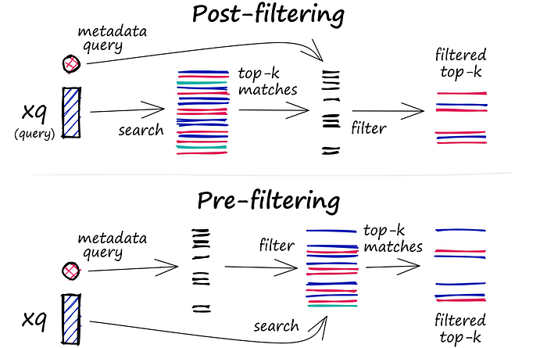
Filtering
Every vector stored in the database also includes metadata. In addition to the ability to query for similar vectors, vector databases can also filter the results based on a metadata query. To do this, the vector database usually maintains two indexes: a vector index and a metadata index. It then performs the metadata filtering either before or after the vector search itself, but in either case, there are difficulties that cause the query process to slow down.

Slide 69
Filtering
The filtering process can be performed either before or after the vector search itself, but each approach has its challenges that may impact the query performance:
Pre-filtering: In this approach, metadata filtering is done before the vector search. While this can help reduce the search space, it may also cause the system to overlook relevant results that don’t match the metadata filter criteria. Additionally, extensive metadata filtering may slow down the query process due to the added computational overhead.
Post-filtering: In this approach, the metadata filtering is done after the vector search. This can help ensure that all relevant results are considered, but it may also introduce additional overhead and slow down the query process as irrelevant results need to be filtered out after the search is complete.
To optimize the filtering process, vector databases use various techniques, such as leveraging advanced indexing methods for metadata or using parallel processing to speed up the filtering tasks. Balancing the trade-offs between search performance and filtering accuracy is essential for providing efficient and relevant query results in vector databases.

Slide 70
Choosing a Vector Database
Open-Source and hosted cloud: If you lean towards open-source solutions, Weaviate, Milvus, and Chroma emerge as top contenders. Pinecone, although not open-source, shines with its developer experience and a robust fully hosted solution.
Performance: When it comes to raw performance in queries per second, Milvus takes the lead, closely followed by Weaviate and Qdrant. However, in terms of latency, Pinecone and Milvus both offer impressive sub-2ms results. If multiple pods are added for Pinecone, then much higher QPS can be reached.
Community Strength: Milvus boasts the largest community presence, followed by Weaviate and Elasticsearch. A strong community often translates to better support, enhancements, and bug fixes.

Slide 71
Choosing a Vector Database
Scalability, advanced features and security: Role-based access control, a feature crucial for many enterprise applications, is found in Pinecone, Milvus, and Elasticsearch. On the scaling front, dynamic segment placement is offered by Milvus and Chroma, making them suitable for ever-evolving datasets. If you need a database with a wide array of index types, Milvus’ support for 11 different types is unmatched. While hybrid search is well-supported across the board, Elasticsearch does fall short in terms of disk index support.
Pricing: For startups or projects on a budget, Qdrant’s estimated $9 pricing for 50k vectors is hard to beat. On the other end of the spectrum, for larger projects requiring high performance, Pinecone and Milvus offer competitive pricing tiers.

Slide 72
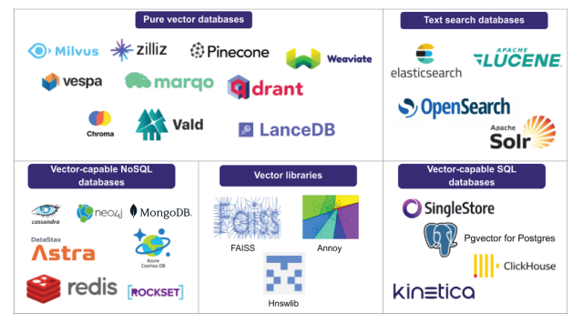
Choosing a Vector Database
In conclusion, there’s no one-size-fits-all when it comes to vector databases. The ideal choice varies based on specific project needs, budget constraints, and personal preferences.

Slide 73
Comparison Parameters
Is open source: Indicates if the software’s source code is freely available to the public, allowing developers to review, modify, and distribute the software.
Self-host: Specifies if the database can be hosted on a user’s own infrastructure rather than being dependent on a third-party cloud service.
Cloud management: Offers an interface for database cloud management
Purpose-built for Vectors: This means the database was specifically designed with vector storage and retrieval in mind, rather than being a general database with added vector capabilities.
Developer experience: Evaluates how user-friendly and intuitive it is for developers to work with the database, considering aspects like documentation, SDKs, and API design.

Slide 74
Comparison Parameters
Community: Assesses the size and activity of the developer community around the database. A strong community often indicates good support, contributions, and the potential for continued development.
Queries per second: How many queries the database can handle per second using a specific dataset for benchmarking (in this case, the nytimes-256-angular dataset)
Latency: the delay (in milliseconds) between initiating a request and receiving a response. 95% of query latencies fall under the specified time for the nytimes-256-angular dataset.
Supported index types: Refers to the various indexing techniques the database supports, which can influence search speed and accuracy. Some vector databases may support multiple indexing types like HNSW, IVF, and more.

Slide 75
Comparison Parameters
Hybrid Search: Determines if the database allows for combining traditional (scalar) queries with vector queries. This can be crucial for applications that need to filter results based on non-vector criteria.
Disk index support: Indicates if the database supports storing indexes on disk. This is essential for handling large datasets that cannot fit into memory.
Role-based access control: Checks if the database has security mechanisms that allow permissions to be granted to specific roles or users, enhancing data security.

Slide 76
Comparison Parameters
Dynamic segment placement vs. static data sharding: Refers to how the database manages data distribution and scaling. Dynamic segment placement allows for more flexible data distribution based on real-time needs, while static data sharding divides data into predetermined segments.
Free hosted tier: Specifies if the database provider offers a free cloud-hosted version, allowing users to test or use the database without initial investment.
Pricing (50k vectors @1536) and Pricing (20M vectors, 20M req. @768): Provides information on the cost associated with storing and querying specific amounts of data, giving an insight into the database’s cost-effectiveness for both small and large-scale use cases.

Slide 77
Conclusions
This provided us with a concise exploration of vector databases, focusing on their crucial role in Retrieval-Augmented Generation (RAG) applications. Highlighting popular databases like ChromaDB, Pinecone, and Weaviate, the author emphasizes the importance of efficient storage and retrieval for optimal RAG performance.
This dives into various indexing techniques and algorithms, offering insights into Annoy, Inverted File (IVF) Indexing, Random Projection, Product Quantization, Locality-Sensitive Hashing (LSH), HNSW, and DBSCAN. It further explains similarity measures like cosine similarity, Euclidean distance, and dot product, with practical applications in document similarity, image retrieval, and collaborative filtering.
A significant portion is dedicated to aiding readers in choosing the right vector database. Key factors such as open-source availability, performance, community strength, scalability, advanced features, security, and pricing are considered. The comparison parameters offer a quick summary, empowering readers to make informed decisions tailored to their specific needs and preferences.
In conclusion, the blog serves as a quick guide for those navigating vector databases, providing essential knowledge for seamless integration and optimization of RAG models.

Slide 78
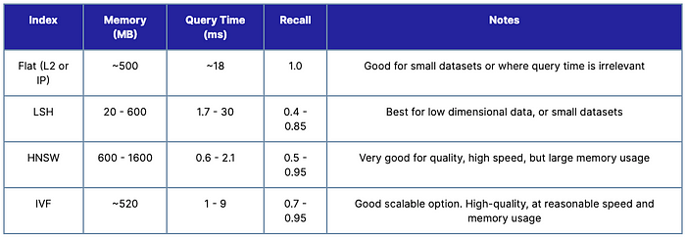
Conclusions

